Slide 1
Free / Libre and
Open Source Software
Prof. Dr. Dirk Riehle
Friedrich-Alexander University Erlangen-Nürnberg
FOSS A01
Licensed under CC BY 4.0 International
Notes:
It is Friedrich-Alexander University Erlangen-Nürnberg – FAU, in short.
Corporate identity wants us to say “Friedrich-Alexander University”.

Slide 2
Open Source is … (First Take) [1]
Software
  that is provided to its users for free under an open source license
A process
  that uses the practices of open collaboration for superior results
[1] Derived from the OSI definition at http://opensource.org

Slide 3
Open vs. Closed Source
Commercial
Open Source
Community
Open Source
open
License
Traditional
Closed Source
Traditional
Consortia
closed
closed
open
Process

Slide 4
Course Topics
Open source basics
  Overview and history
  Intellectual property
Open source projects
  Project communities
  Development processes
  Development tooling
Corporate open source
  Corporate governance
  Corporate open sourcing
  Inner sourcing
Open source economics
  Developer foundations
  User foundations
  Service and support firms
  Distributor firms
  Single-vendor firms
Software developers
  Labor economics

Slide 5
Course Learning Goals
Students will gain a conceptual understanding of
  key aspects of the software industry
  how open source software projects work
  how open source is changing the software industry
Students will acquire a practical understanding of
  simple tasks involved in each of the course topics

Slide 6
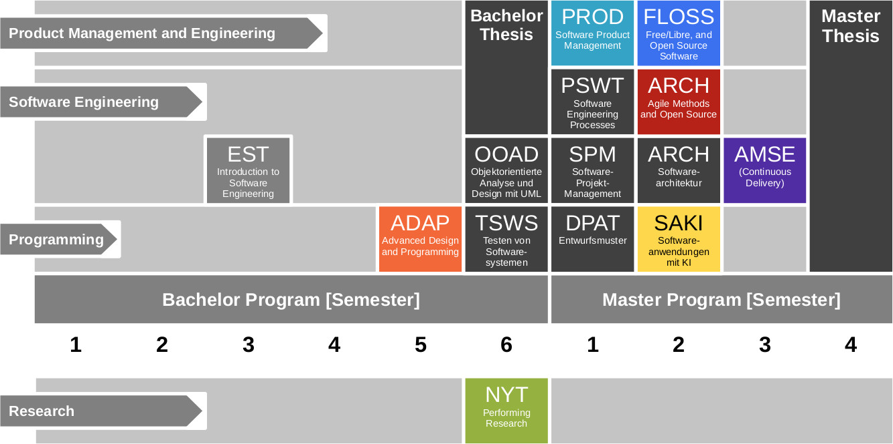
Course Position in Curriculum

Slide 7
Courses and Modules
 |  | Courses (Lehrveranstaltungen)
 |  | OSS-FLOSS-VUE |  | Total ECTS
Modules | OSS-FLOSS | x |  | 5
NYT can be taken as
  5 ECTS VL + UE
  5 ECTS Seminar
  10 ECTS VL + UE
  10 ECTS Project
In various degree programs
Also as a Schlüsselqualifikation
VUE = Lecture + exercise (Vorlesung + Übung)
PROJ = Project

Slide 8


Slide 9
Course Grading [1]
Class discussion (4 SWS) = 60 / 150 = 40%
  Where class = lecture + exercise
  Graded using [0|1|2|3] scheme
Homework deliverables = 90 / 150 = 60%
  Reduced to class quizzes this semester
  Graded using [0..10] scheme
[1] Also see http://osr.cs.fau.de/teaching/course-resources/grading-schemes-and-scales/

Slide 10
Active Participation
Showing up +
listening to the lecturer +
thinking about what you are hearing +
verbalizing your thoughts (speaking up) +
answering to someone else's thoughts +
collaborating to solve a problem +
adequate use of air-time

Slide 11
Class Quizzes
Each class session starts with a class quiz
  A quiz will test your understanding of last session’s lecture(s)
  A quiz typically has 5 questions and will last 10 minutes
  The overall quiz is graded using [0..10] scheme (10 points in total)
A class quiz will open precisely when class starts
  The quiz is administered automatically through StudOn
  It is your job to have reliable Internet access etc.
  There is no way to make up for a missed quiz
Please see the StudOn quiz FAQ https://bit.ly/2JpgjnQ

Slide 12
Grading Rubric for Deliverables
Categories | Points |  |  |  |  | Criteria
 | Disagree | Disagree some | Neutral | Agree some | Agree
Form (10%) | Does the deliverable meet formal requirements? |  |  |  |  | Does the deliverable meet page length requirements, is written in the right language, etc.?
Language (10%) | Is the language clear, concise, and helpful? |  |  |  |  | Are sentences complete, is the grammar correct, are statements coherent, etc.?
Structure (20-30%) | Does the deliverable have a clear logical structure? |  |  |  |  | Does the deliverable follow established or suggested structure? Is the argument logical, etc.?
Content (50-60%) | Does the discussion touch on all relevant issues? |  |  |  |  | As a reference, use your own deliverable as well as what you learned in class.

Slide 13
Requirement for Passing Course
At least 50% participation in all grade-relevant components
  Class discussion
  Homework deliverables

Slide 14
Receiving a Grade for the Course
If you want to receive a grade
  You must register through the course management system before the deadline
If you cannot register through the course management system
  Please follow these instructions https://wp.me/PDU66-2bx
Otherwise: No grade

Slide 15

No Oral or Written Exam [1]
[1] You still have to register for the course

Slide 16
Course Language [1]
Class
  Lecturer: English
  Student: Choice of German or English
Homework
  Submissions: English
[1] See http://osr.cs.fau.de/2012/03/10/english-or-german-deutsch-oder-englisch/

Slide 17

Course Communication
Announcements by email (through StudOn)
Questions and answers using FSI Forum for course
If you must send email, use the teaching team alias from course index

Slide 18
Course Information
Course index
  https://goo.gl/czKB5y
Course reader
  https://goo.gl/AvSJNi

Slide 19
Thank you! Questions?
dirk.riehle@fau.de – http://osr.cs.fau.de
dirk@riehle.org – http://dirkriehle.com – @dirkriehle
DR

Slide 20
Credits and License
Original version
  © 2012-2019 Dirk Riehle, some rights reserved
  Licensed under Creative Commons Attribution 4.0 International License
Contributions
  ...

